Slide 1

Safety of information systems
Fault-tolerant systems
Roman Danel
roman.danel@vsb.cz
VŠB – TU Ostrava

Slide 2
  Fault-tolerant System - a system resistant to failures - failure of the system will not cause significant interruption to the system; solutions through duplication of critical components
Disaster Tolerant System - a system resistant to disasters - just like Fault-tolerant System it uses duplication but additionally it physically separates the backup system (to a different building, different city…)

Slide 3
Uptime - refer to periods when a system is available
Downtime - refer to periods when a system is unavailable
MTBF - Mean Time Between Failure - is the predicted elapsed time between inherent failures of a system during operation
MTTR - Mean Time to Repair - represents the average time required to repair a failed component or device
Mean time to recovery - the average time that a device will take to recover from any failure

Slide 4
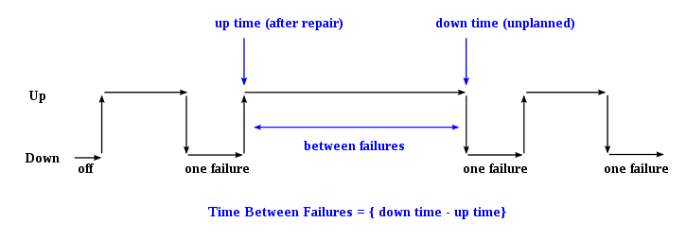

Slide 5
IBM Disaster Recovery Layer
Layer 0 – No off-site data
Layer 1 – Data backup with no Hot Site
Layer 2 – Data backup with a Hot Site
Layer 3 – Electronic vaulting
Layer 4 – Point-in-time copies
Layer 5 – Transaction integrity
Layer 6 – Zero or little data loss
Layer 7 – Highly automated, business-integrated solution

Slide 6
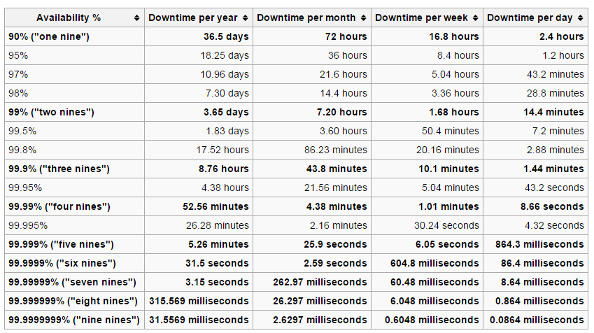
High Availability

Slide 7
Solution
Redundancy
Replication
Diversity

Slide 8
Database Technologies for FT
Log shipping
Replikace
Mirroring
Clustering

Slide 9
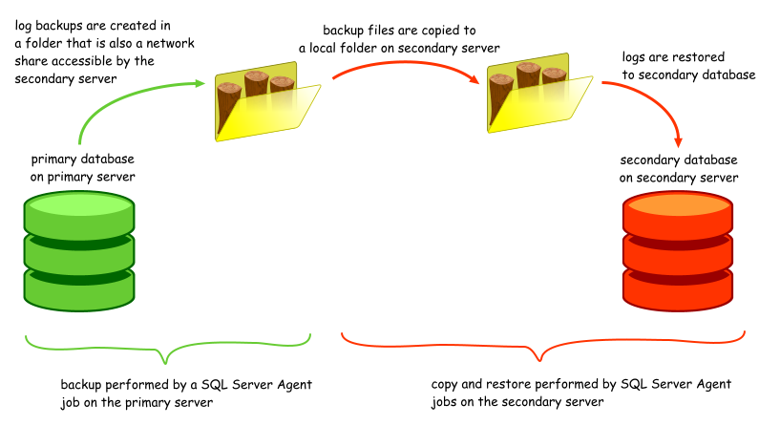
Log Shipping
Source: www.sqlbackuprestore.com

Slide 10
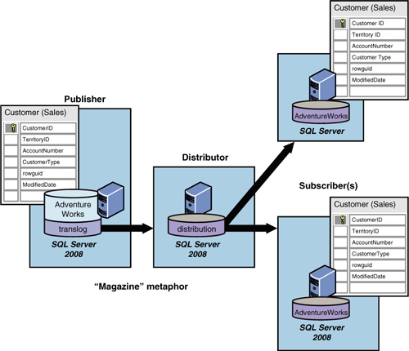
Replication
Notes:
Source: Microsoft MSDN

Slide 11
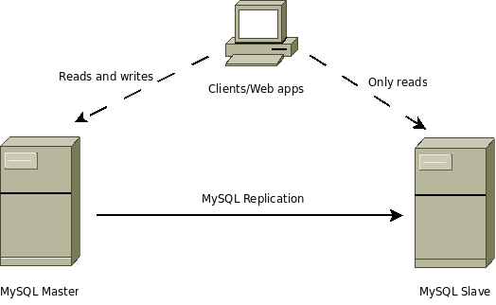
Replication in MySQL
Notes:
https://www.percona.com/blog/2009/11/13/finding-your-mysql-high-availability-solution-%E2%80%93-replication/

Slide 12
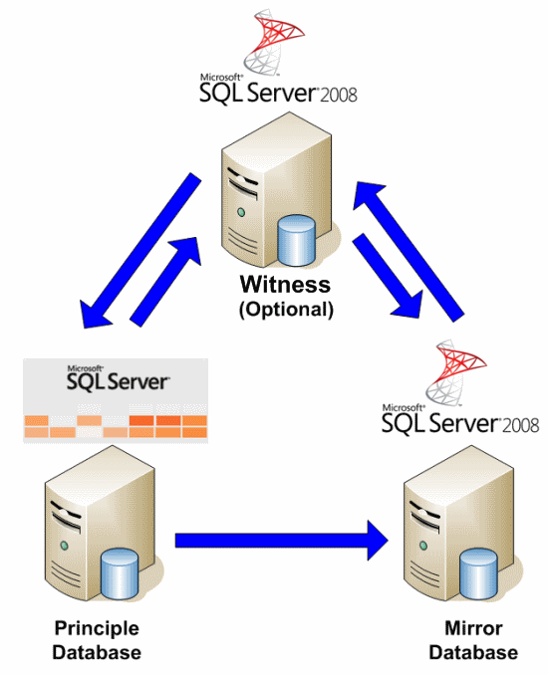
Mirroring

Slide 13
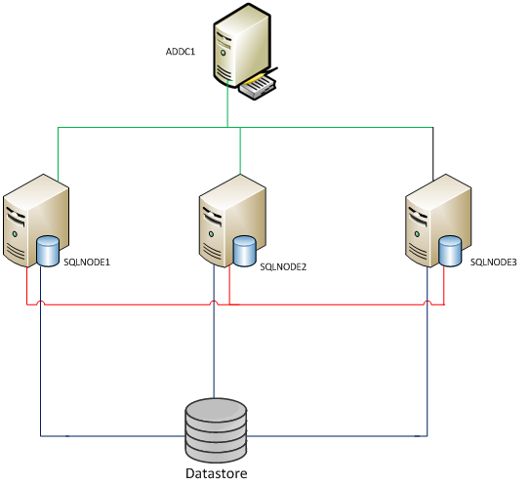
Always-on

Slide 14
SQL SERVER MIRRORING - EXAMPLE

Slide 15
First steps – setup a database
Create a master key (master key is used for certificate)
Create certificate
Create login
Export certificate to a file
Move and import certificate

Slide 16
use master;
create master key encryption by password='xxxx';
create certificate SERVER_P_cert with
subject='SERVER_P certificate', start_date='20180101';
create login HOST_SERVER_M_login with password = 'xxxx';
create user HOST_SERVER_M_user for login HOST_SERVER_M_login;
/* backup certificate on SERVER_P for Transfer to SERVER_M */
backup certificate SERVER_P_cert to file = 'c:\sql\certif\SERVER_P_cert.txt';
/* load certificate from SERVER_M */
create certificate HOST_SERVER_M_cert
authorization HOST_SERVER_M_user
from file = 'C:\sql\certif\SERVER_M_cert.txt';
/* check of installed certificates */
select * from sys.certificates;

Slide 17
TCP Endpoint
create ENDPOINT [mirror_ep] STATE=STARTED
AS TCP (LISTENER_PORT = 5022,
LISTENER_IP = ALL)
FOR DATA_MIRRORING (ROLE = ALL, AUTHENTICATION = CERTIFICATE SERVER_P_cert, ENCRYPTION=REQUIRED ALGORITHM AES);

Slide 18
Grant Access Rights
GRANT CONNECT ON ENDPOINT::Mirror_ep TO [HOST_SERVER_M_login];
This command allows access to SERVER_P endpoint from SERVER_M (mirror server) via certificate SERVER_P_cert (which must be loaded on SERVER_M)

Slide 19
Activation of the mirroring
Full backup of principal database
Transaction log backup of principal database
Restore of full backup on mirror server (in recovery mode)
Restore of transaction log on mirror database
Start the mirror

Slide 20
Backup db and log from Principal
/* full backup of database “db_name” */
backup database db_name to disk='c:\data\mssql\db_name.bak' with format;
/* backup of transaction log */
backup log db_name to disk='c:\data\mssql\b_name_log.bak' with format;

Slide 21
Restore db and log on Backup
restore database db_name from disk='C:\data\mssql\db_name.bak'
with norecovery, replace;
/* restore transaction log on SERVER_M */
restore log db_name from disk='c:\data\mssql\db_name_log.bak'
with norecovery;

Slide 22
Final step – start the mirroring
/* start the mirror on SERVER_M */
alter database db_name
set partner='tcp://SERVER_P:5022';
/* start the mirror on SERVER_P */
alter database db_name
set partner='tcp://SERVER_M:5022';

Slide 23
Notes
When we do the database and log backup of principal database, the best practice is to do truncation of log file before
Successfully established mirror is indicated by “synchronizing” status in the list of databases in SQL Server Management Studio.
“Partner not found” error message after “alter” command is likely to incorrect access point settings

Slide 24
Test the database status
select sdb.name,isnull( mirroring_state_desc, 'NOT ACTIVE'), isnull(mirroring_partner_name, 'NONE'), isnull(mirroring_role_desc, 'N/A'),isnull(mirroring_safety_level_d esc, 'N/A')
from sys.database_mirroring sdm, sys.databases sdb
where sdb.database_id = sdm.database_id and name = 'db_name';

Slide 25
Disconnect the mirror
alter database db_name set partner off;
/* turn off the recovery mode */
restore database db_name;

Slide 26
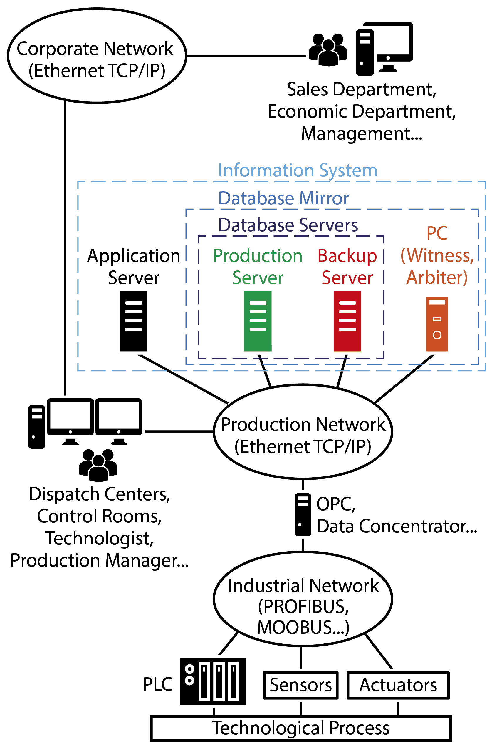

Slide 27
